Slide 1

Data-Driven Insights for Donor Selection: A Machine Learning Approach
By Onyero Walter Ofuzim
9th September 2023

Slide 2
Introduction
- Let's delve into the world of data-driven insights to empower a national charitable organization.
- Their mission, as a charitable organization, is to make a positive difference in the lives of those in need.
- To achieve this, we rely on the generosity of our donors, who support us in our noble cause.
- I embarked on a journey to leverage data science and machine learning to optimize our fundraising efforts.
Presentation Objective:
- The primary objective of this presentation is to unveil actionable insights derived from data analysis.
- We will explore how we can identify prospects who are most likely to become valuable donors in our upcoming campaign.
- By focusing our efforts on these prospects, we can reduce costs associated with solicitation and direct more resources toward our charitable endeavors.

Slide 3
Data Overview
The Data Sets:
Two datasets that serve as the foundation of this project:
Donor Raw Data: This dataset contains historical information about our past donors. It includes a wealth of details about their interactions with our campaigns, donations, demographics, and more. Crucially, it also includes a target variable, "TARGET_B," indicating whether these donors have contributed to our campaigns.
Prospective Donors: The second dataset is a list of new contacts that we plan to approach in our upcoming campaign. These individuals are our potential future donors.

Slide 4
Data Preprocessing
Data preprocessing is a critical step in preparing our datasets for analysis and modeling. It involves cleaning and transforming the data to ensure its quality, consistency, and suitability for machine learning algorithms. In this section, we'll discuss how we handled missing values and irregular data entries in our "Donor Raw Data" and "Prospective Donors" datasets.
Handling Missing Values: Missing data can have a significant impact on the accuracy and reliability of our analysis. We addressed missing values using the following techniques:
Missing fields
Target_D – Zero imputation
Donor_Age – median imputation
Income_Group – mode imputation
Wealth_Rating, - Used income group as a metric
Months_Since_Last_Prom_Response – Removed missing rows (246, 19372)
Handling Irregular Values: We also addressed irregular data entries, specifically in the column "CLUSTER_CODE."
Data preprocessing ensures that our datasets are clean, consistent, and ready for the subsequent stages of analysis and modeling.

Slide 5
Feature Selection
Feature selection is an important step in machine learning model development as it helps improve model performance and reduces overfitting. In this section, we will discuss the process of feature selection using correlation analysis and chi-squared tests, along with the features selected for modeling.
Correlation Analysis: Correlation analysis is a statistical method used to measure and evaluate the relationship between two or more variables. In the context of feature selection for machine learning, correlation analysis helps identify how strongly a particular feature is related to the target variable or other features.
Chi-Squared Tests: Univariate feature selection is a technique that evaluates the relationship between each individual feature and the target variable independently. It is particularly suitable for categorical features or variables with discrete values. Features with p-values below a predefined significance level (such as 0.05) are considered statistically significant and are retained for modeling. Those with p-values above the threshold are considered less relevant and may be excluded.

Slide 6
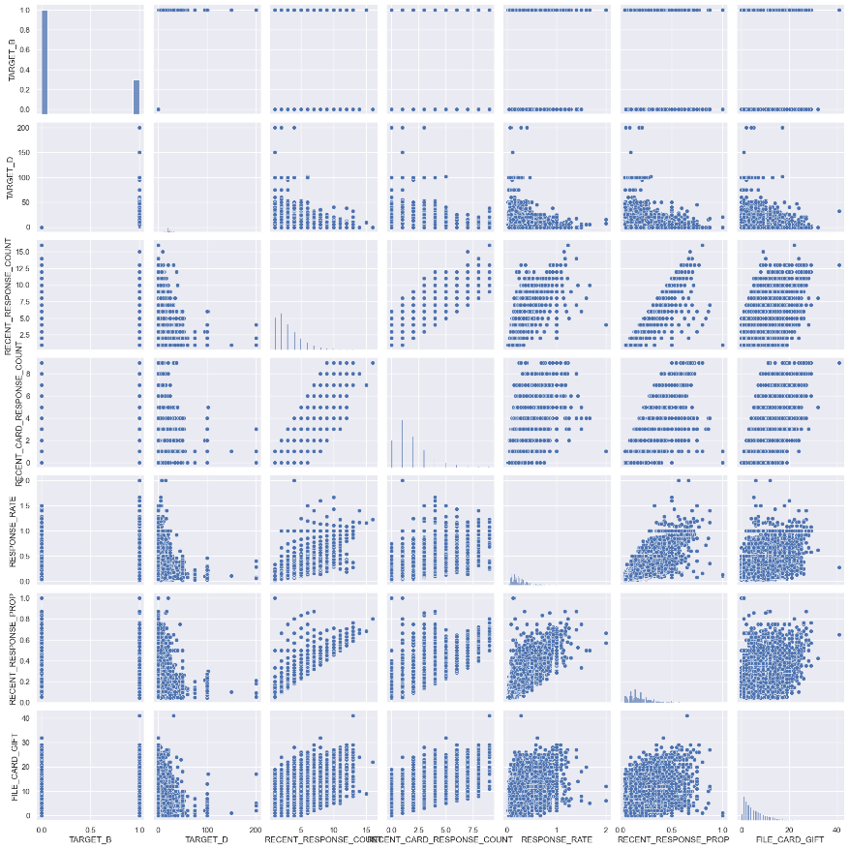
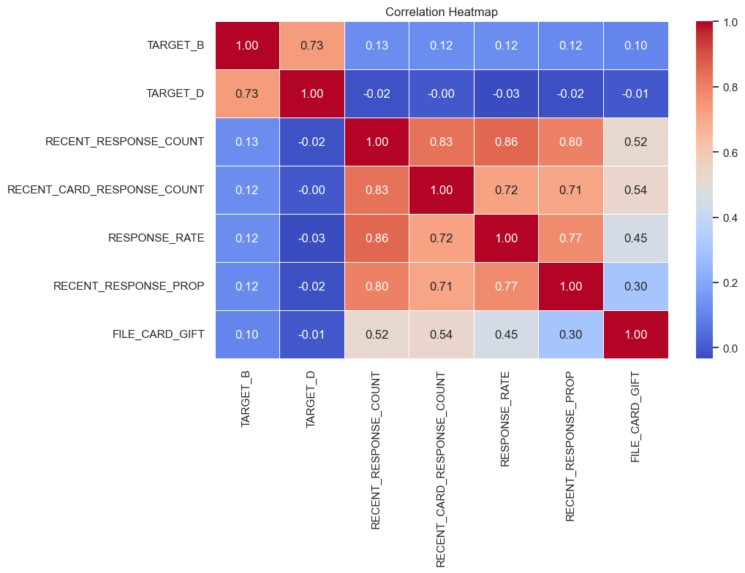
Exploratory Data Analysis (EDA)
Exploratory Data Analysis (EDA) is a crucial step in understanding our datasets. It allows us to visualize, summarize, and interpret the key characteristics and relationships within the data. In this section, we present some of the key EDA visualizations and their insights.

Slide 7
Machine Learning Model
Random Forest Classifier
Random Forest Classifier is a machine learning algorithm known for its robustness and effectiveness in various predictive tasks like applications such as classification of diseases, customer churn prediction, recommendation systems, and more.
Model Evaluation
- Model accuracy and classification report results were generated to assess its performance.
- Accuracy: 71.69%
- Classification Report:
precision recall f1-score support
0 0.74 0.95 0.83 2823
1 0.30 0.06 0.10 1003
accuracy 0.72 3826
macro avg 0.52 0.51 0.47 3826
weighted avg 0.63 0.72 0.64 3826

Slide 8
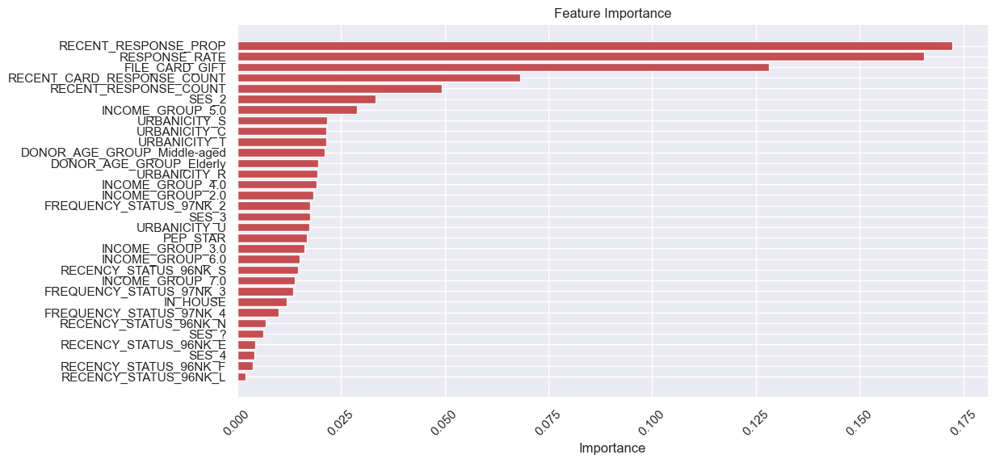
Model Insights
Implications for Donor Selection
- Targeted Outreach: Focus efforts on individuals with a high response rate and proportion. They are more likely to respond positively to donation requests.
- Segmentation: Consider demographic factors like SES, income group, and urbanicity when tailoring donation campaigns.
- Age-Related Strategies: Develop age-specific approaches to engage Middle-aged donors effectively.
- Leveraging PEP STAR: Encourage participation in the Patriot Express Program to boost donor engagement.

Slide 9
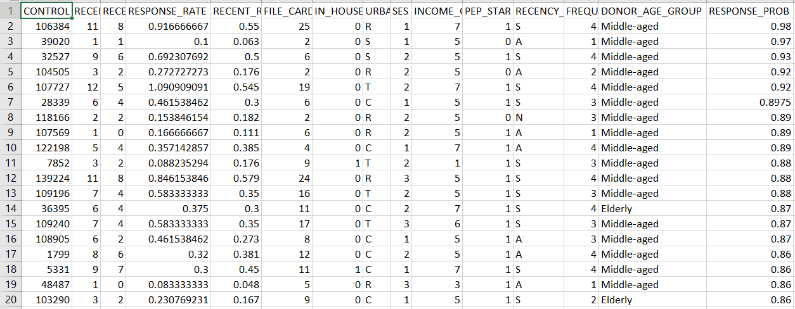
Prospect Selection
## Meet Our Top 100 Prospects!

Slide 10
Thank You!!

